Slide 1
AutoDrive Challenge 2 Weekly Meeting

Slide 2
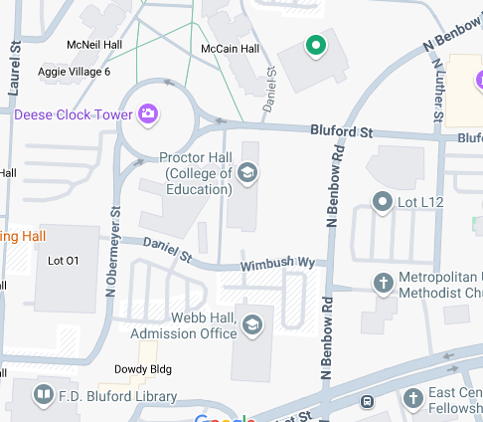
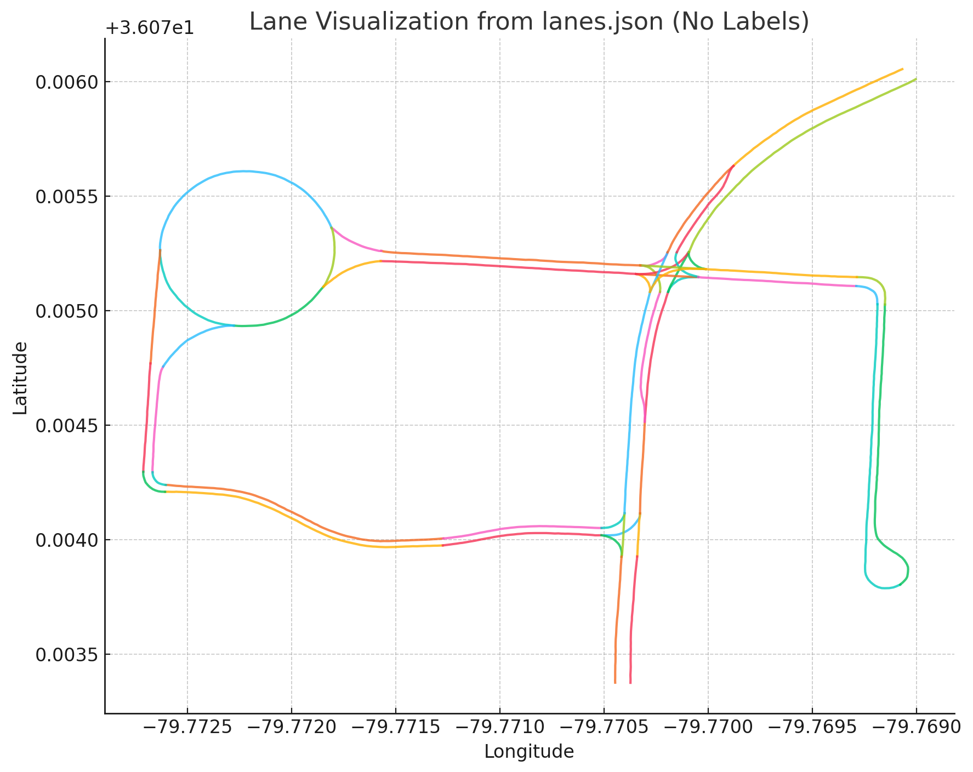
Map information
Google map of Benbow road
Lanes information of Benbow road

Slide 3

A* demo
A* demo

Slide 4
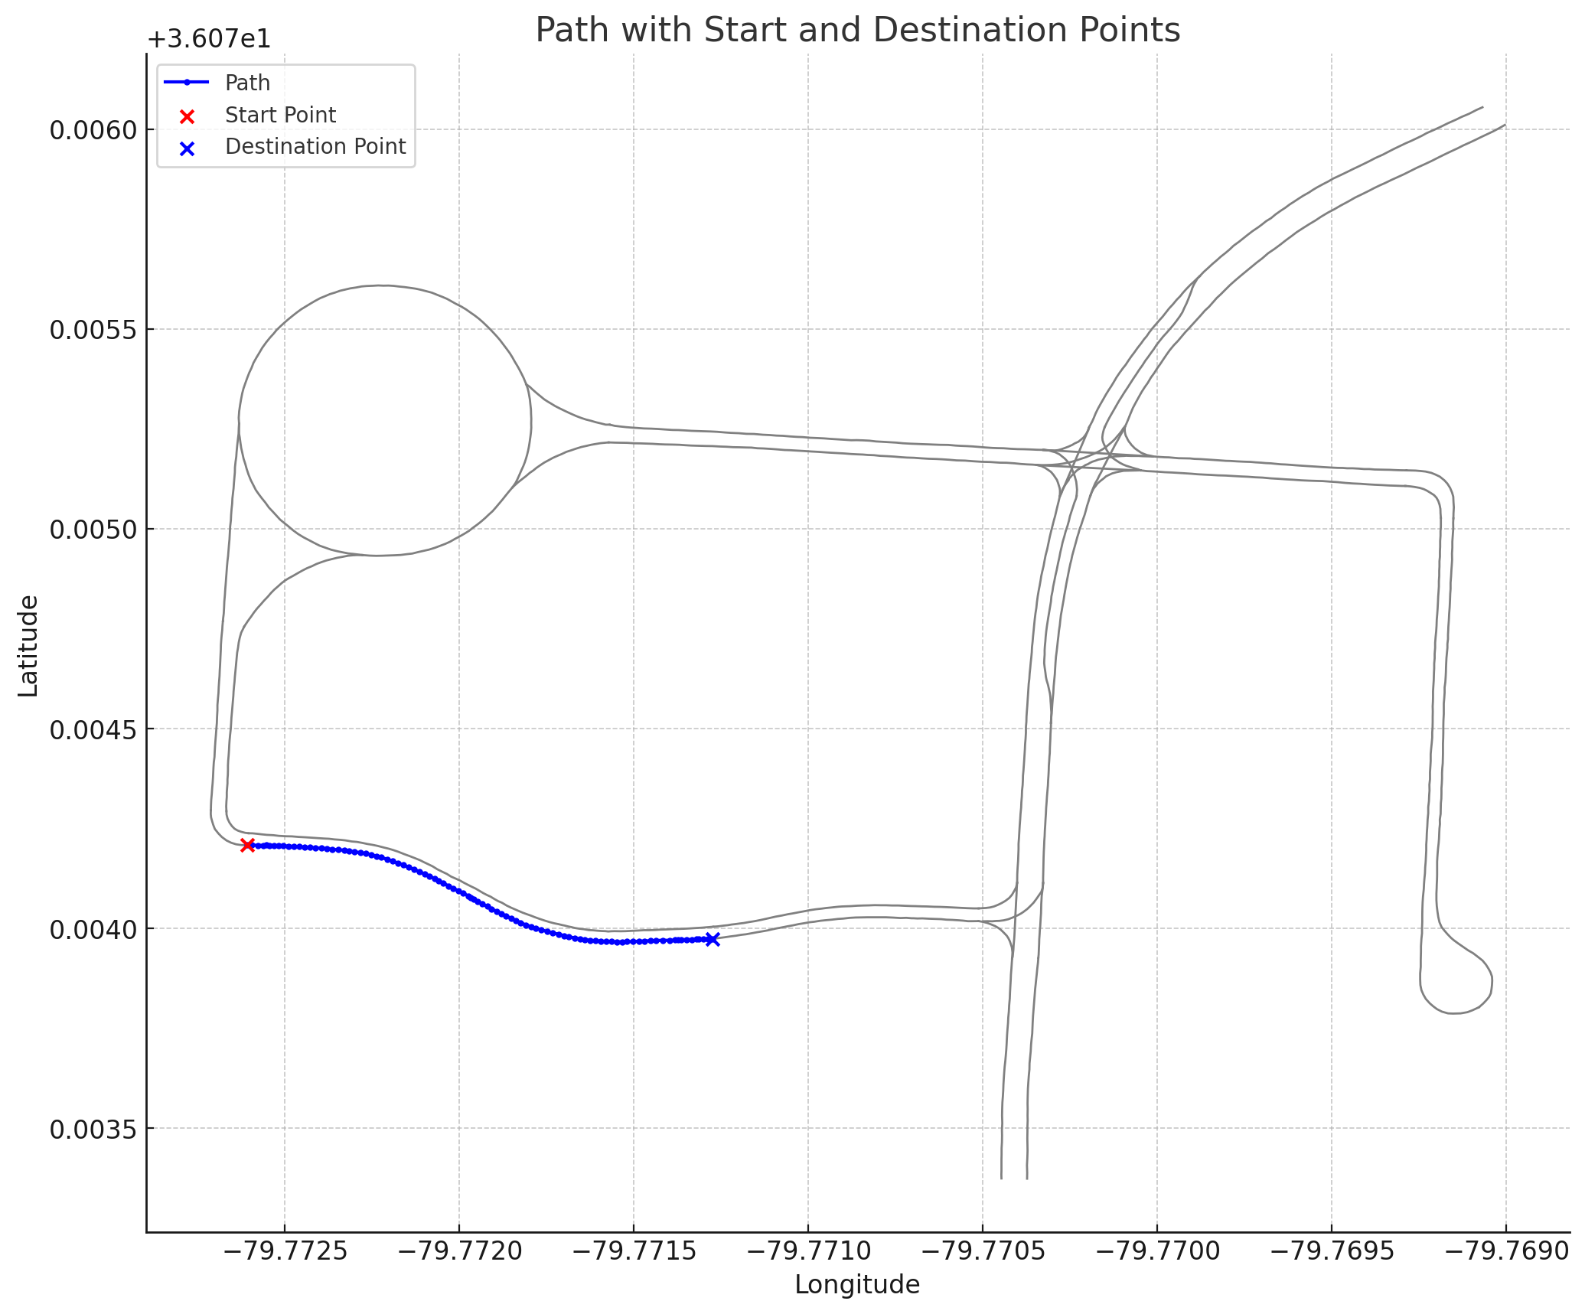
A* result
A* result

